Slide 1
NGOs and Authoritarianism
Andrew Heiss, PhD
Andrew Young School of Policy Studies, Georgia State University
andrewheiss.com • @andrewheiss
November 5, 2019

Slide 2
The Puzzle
Why do dictators let NGOs work in their country?

Slide 3

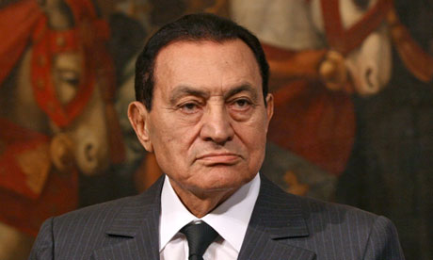

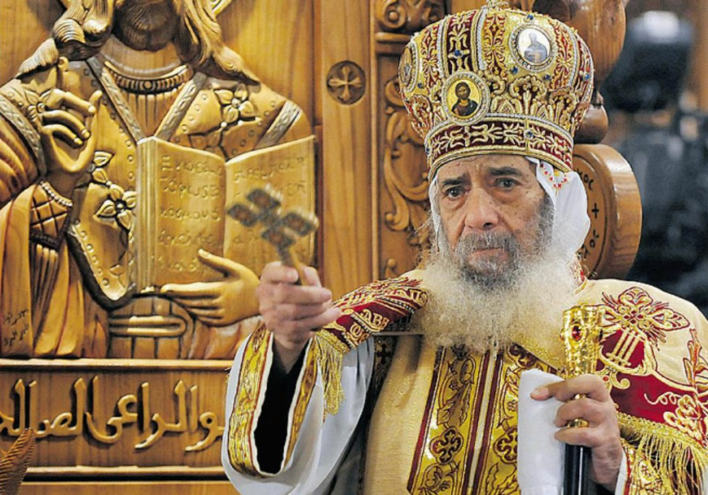


Slide 4

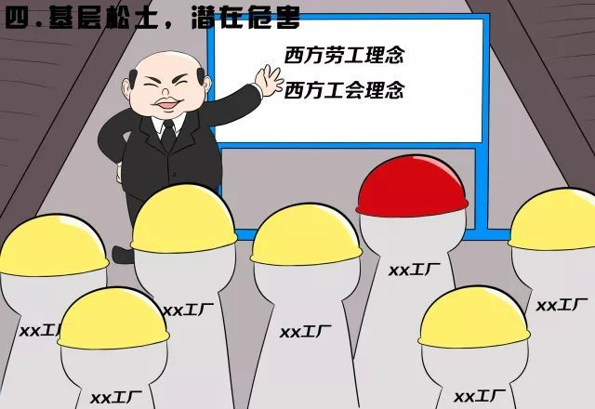
Notes:
National Security Education Day
http://www.sohu.com/a/228225702_391364
https://www.quora.com/What-do-these-Chinese-propaganda-cartoons-say-and-what-is-the-broader-context
https://supchina.com/2018/04/18/national-security-education-day-in-china-puts-emphasis-on-foreign-infiltration/

Slide 5
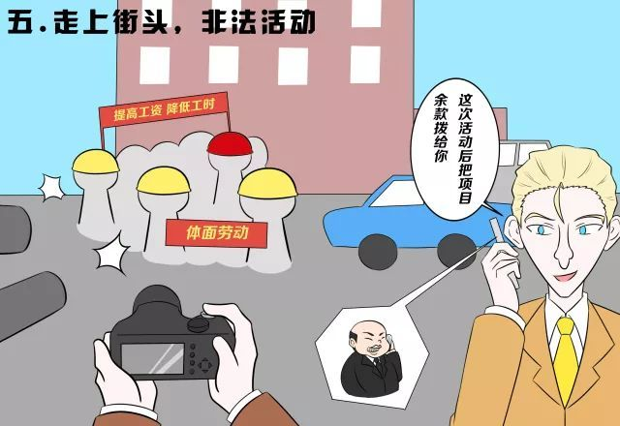

Notes:
China and national security day vs. Greenpeace invited in

Slide 6
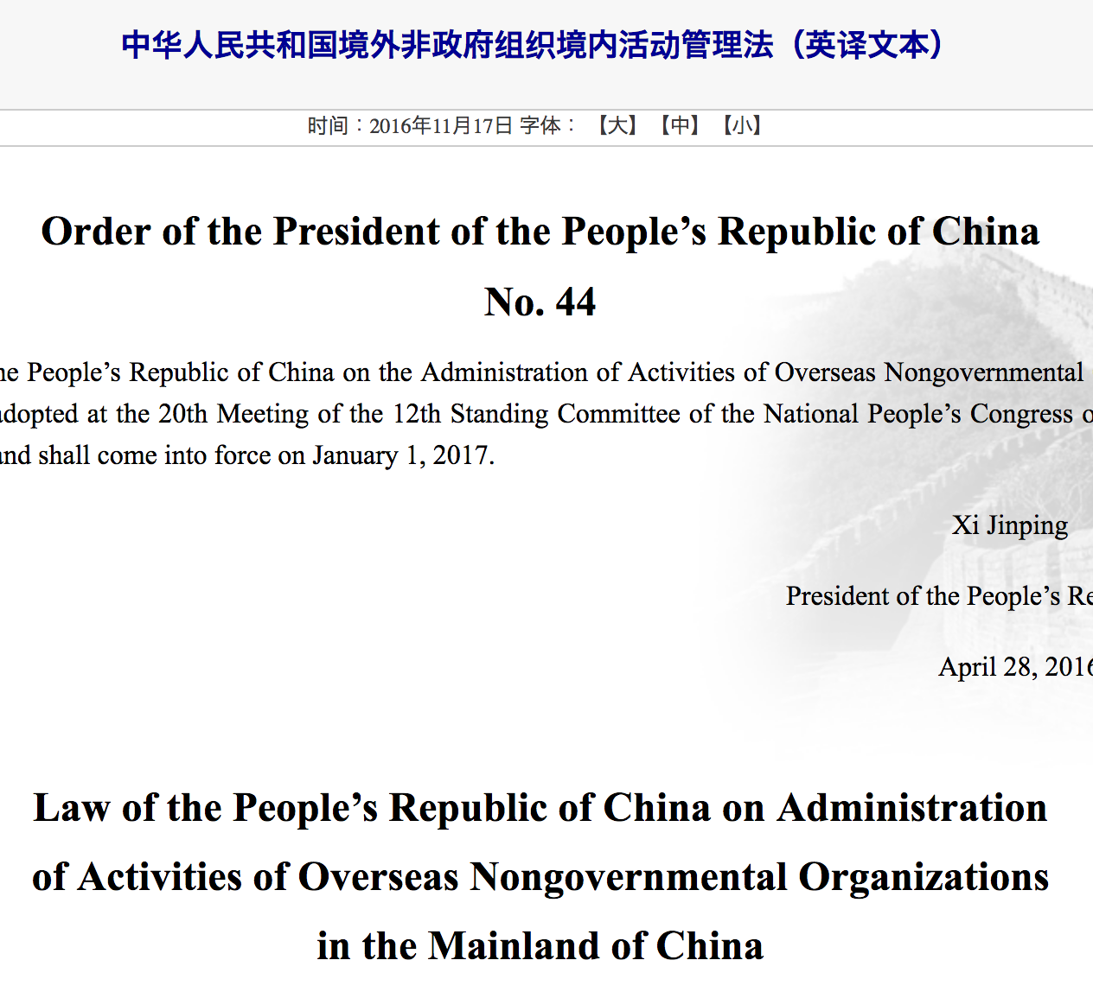


Slide 7
Authoritarian Institutions
Dictators aren’t as stable as they appear

Slide 8
Institutional balancing
To stay in power, dictators must give some power to rival institutions, but in a controlled and safe way

Slide 9
“Donning democratic garb”
Dictators use democratic-ish institutions in the service of regime stability
Parliaments
Protests
Independent judiciary
Central banks

Slide 10
NGOs as Institutions
Collaborators, opponents, or substitutes?

Slide 11
My argument
NGOs are yet another institution that dictators have to deal with when pursuing regime stability

Slide 12
NGOs in dictatorships
Bowling leagues, networks, and supporting state power
“Standing up to city hall” and challenging state power
NGO fiefdoms and replacing state power

Slide 13
NGO Restrictions
Fitting NGOs into authoritarian calculus

Slide 14

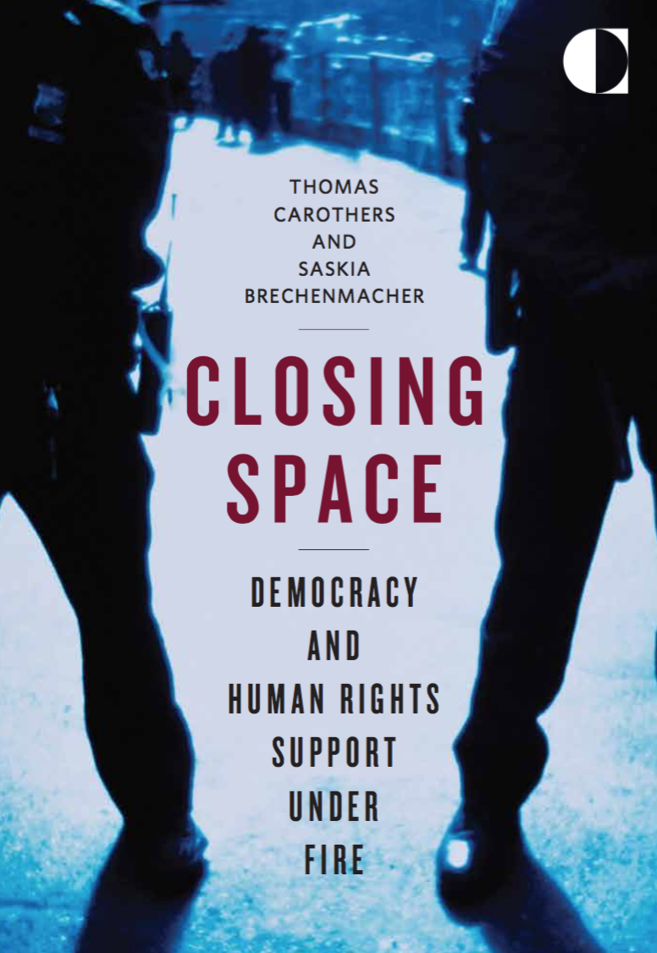


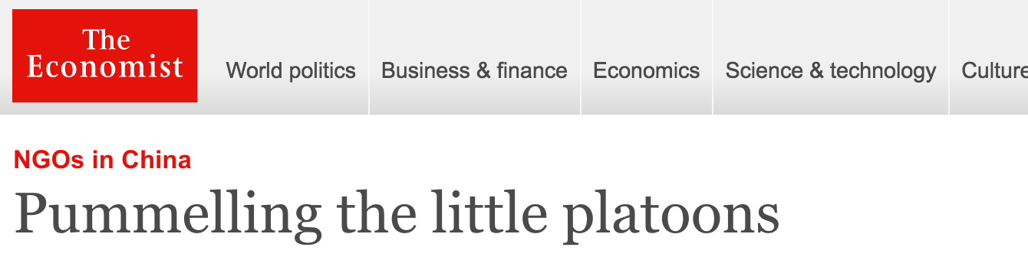

Slide 16
Costs and benefits of NGOs
Coordinated understanding
Provide services for regime
Boomerangs and spirals
Bestow legitimacy to regime

Slide 17
Legal restrictions
Dictators use laws to avoid costs, reap benefits of NGOs
Gatekeeping
Programmatic

Slide 18
Varying enforcement
Passage and enforcement depend on regime needs

Slide 19
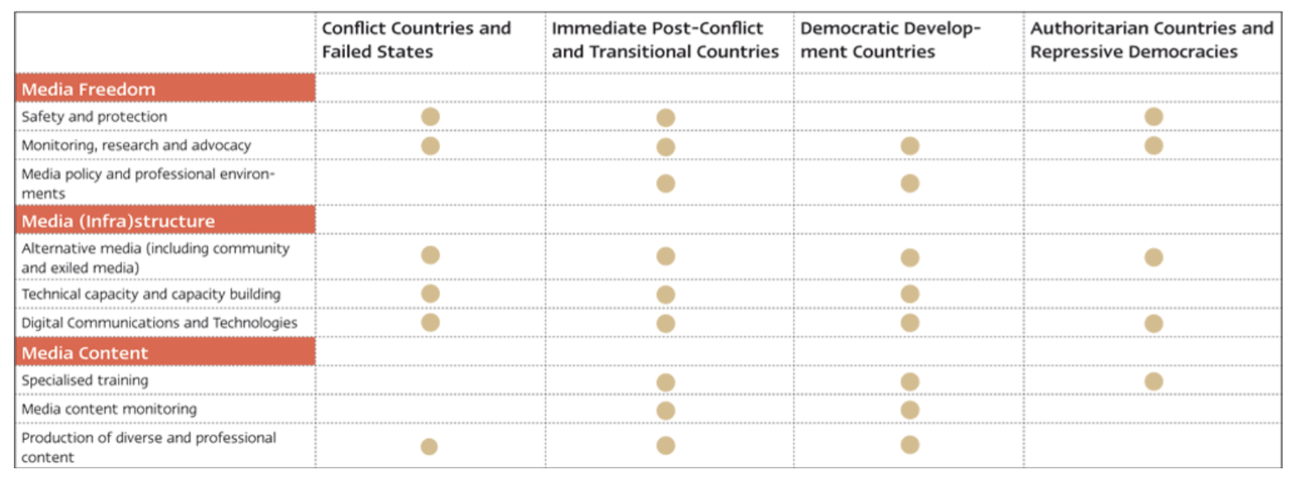
Adjusting to the legal environment
Change staff
Change programs
Change laws
Leave and stop
Leave and sneak

